Slide 1
AIR LOCALIZE 1.1
2D – 3D
Spot Detection & Quantification
Timothee Lionnet, Singer Lab
timothee.lionnet@einstein.yu.edu

Slide 2
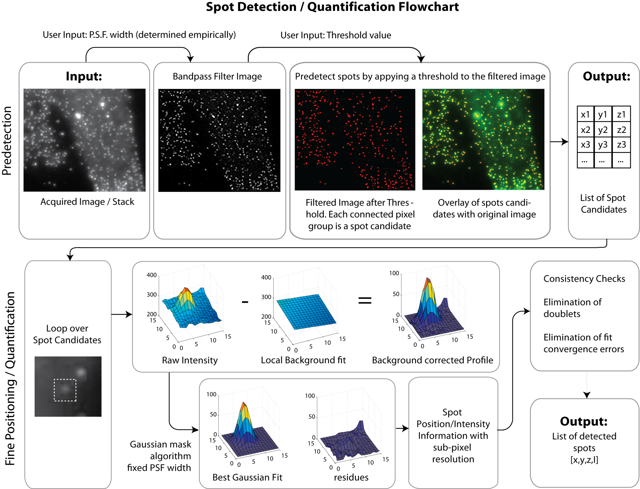

Slide 3
Requirements
Runs only on Windows XP
1) Install MATLAB Compiler Runtime (run MCRInstaller.exe)
2) Open the windows command window (start menu > Run…> cmd)
3) Go to the directory where the AIRLOCALIZE1_1.exe is stored
4) Type AIRLOCALIZE1_1.exe

Slide 4
Single z-stack Analysis: User Input
Chose Input mode
Load file
Select ROI (optional)
Compute PSF settings manually (optional)
Chose Threshold manually (optional)

Slide 5
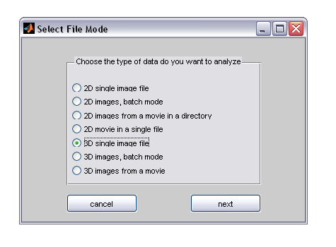
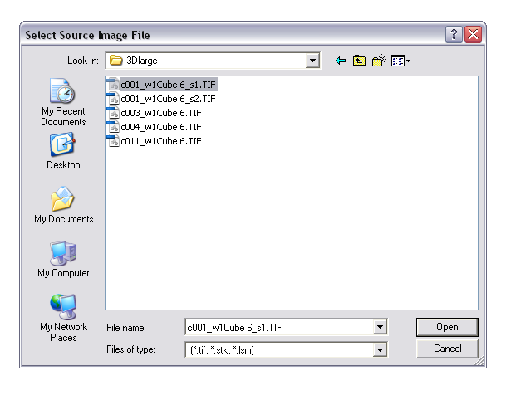
1) Chose input mode:
2) Load your File:

Slide 6
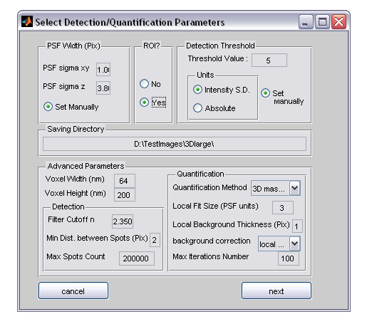
Detection & Quantification Parameters
Check Yes if you only want to analyze a portion of the image (saves computation time)
The width of the PSF resp. laterally and vertically (in pixel units).
If you do not know these,
check “Set Manually”
Threshold Value that sets the detection sensitivity.
You can set it visually if you check “Set Manually”.
Chosing ‘Intensity S.D. ‘ Units can be useful when anayzing a times series with considerable bleaching.
Otherwise use ‘Absolute’
Where your results will be saved
You can safely ignore the Advanced Parameters

Slide 7
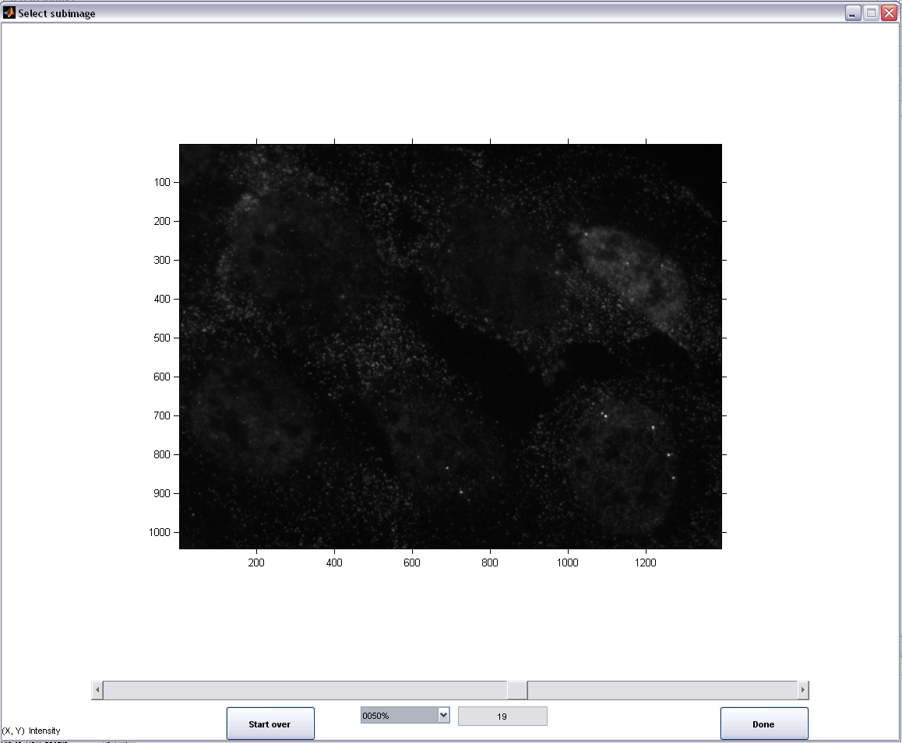
Select a rectangular ROI
A first click determines the position of the first corner. The second click determines the position of the opposite corner.
Navigate your z-stack with this scroll bar

Slide 8
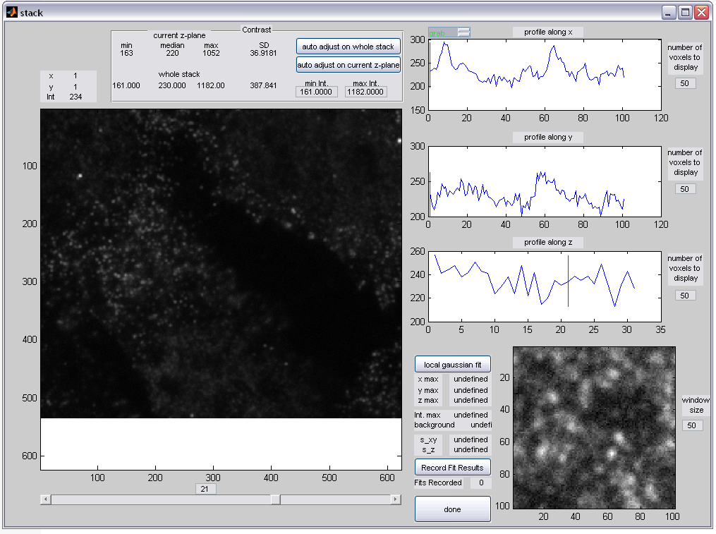
Determine the PSF width (1)
Mouse x,y position & corresponding Intensity
You can change the contrast of the display in this panel
Readout of the snap / grab mode status (see next)
Intensity profile of lines around the current mouse position (marked by the green vertical line). You can change the range of the graphs
Zoom Window centered on the current mouse position;
You can change the window size
Number of the displayed slice
Navigate your z-stack with this scroll bar
Gaussian Fitting Commands (see next)

Slide 9
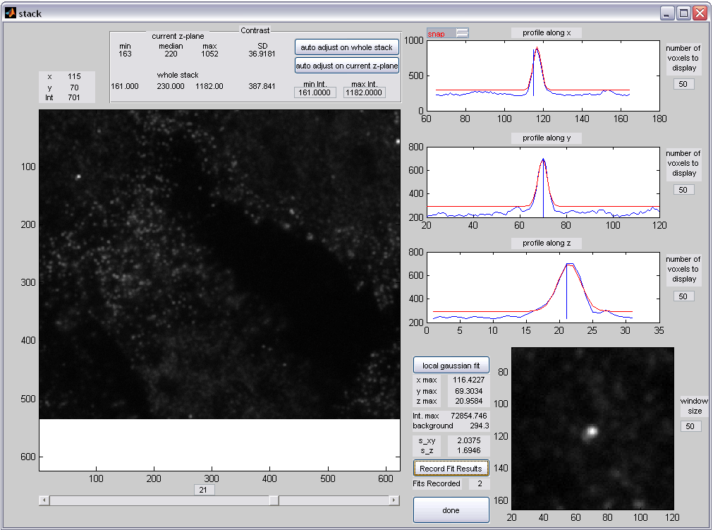

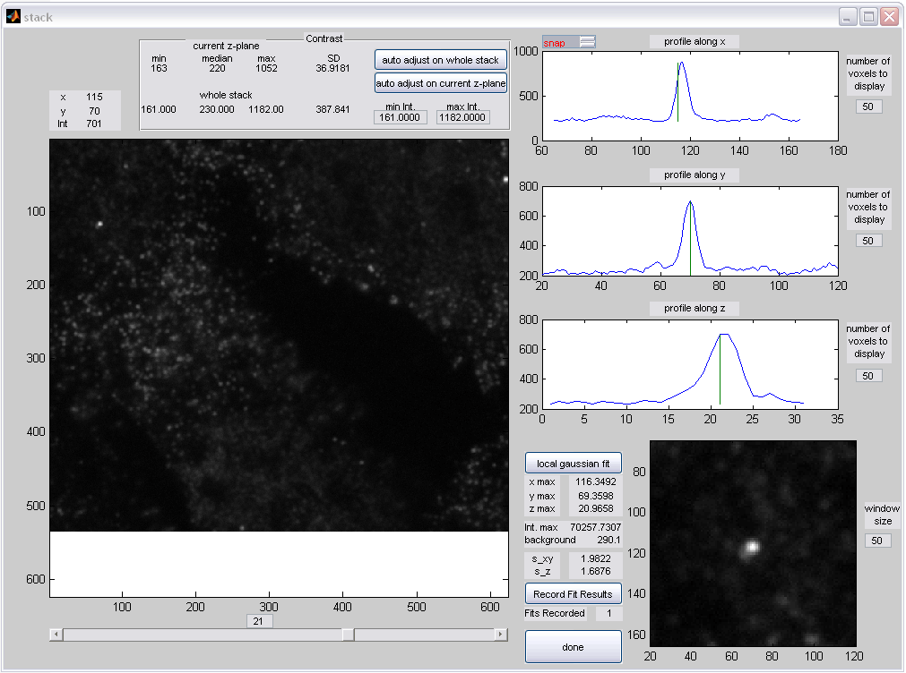
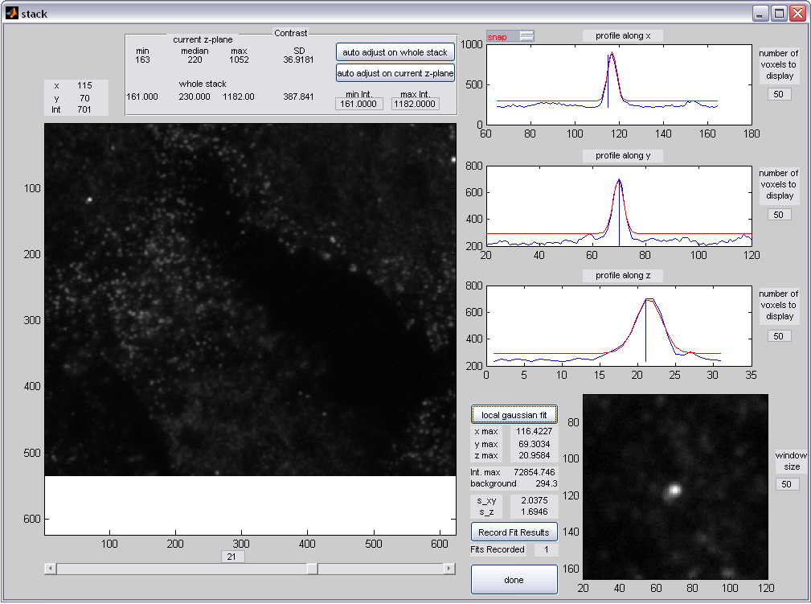
Determine the PSF width (2)
6) Left-click to return to grab mode (the displays of the right panel should now refresh when the mouse moves and the status readout should read grab).
Repeat for a few spots (~10) to determine the average PSF width.
The number of fits recorded should increase each time.
Push the “done” button (Make sure you have at least one fit recorded)
3) Click on the “local gaussian fit” button.
4) Within seconds, the results should appear, and the fitted curve should overlay in red the intensity profiles in the x,y,z displays.
5) If the fit result is correct, click on the “Record Fit Results” button.
Bring your mouse on top of a spot (avoid blobs).
2) Left-click to enter snap mode (the displays of the right panel should not refresh anymore when the mouse moves and the status readout should read snap).

Slide 10
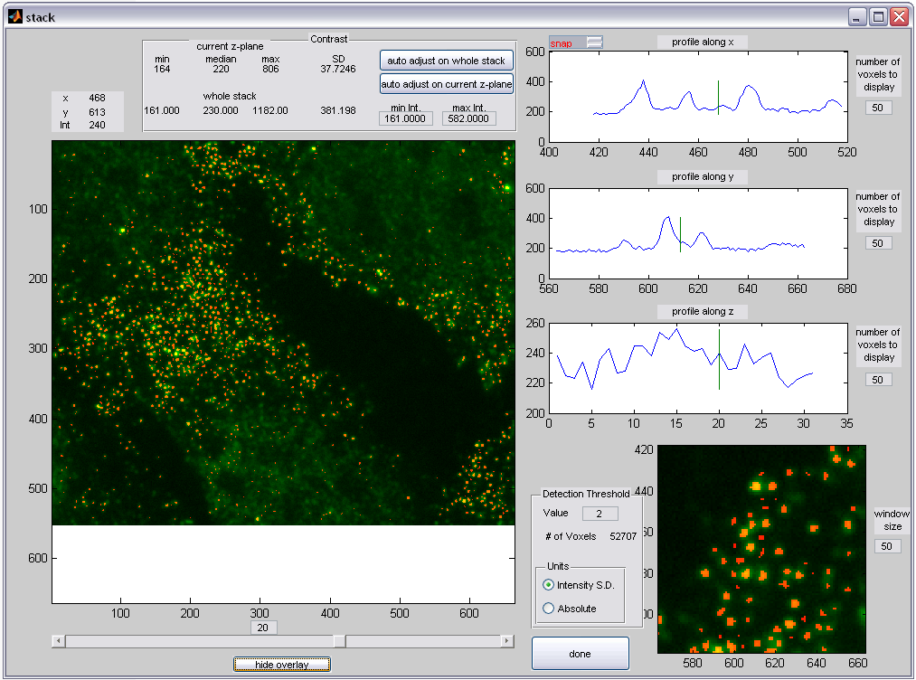
Determine the threshold manually
You can change the contrast of the green channel in this panel
Green: raw data
Red: spot candidates
Adjust the threshold value and check
visually
which spots are selected
Change the threshold value here
Choice of Units: Intensity SD (useful on a timeserie with photobleaching)
Or Absolute
Toggle the overlay that shows the predected spots to compare raw data with the thresholded spots

Slide 11
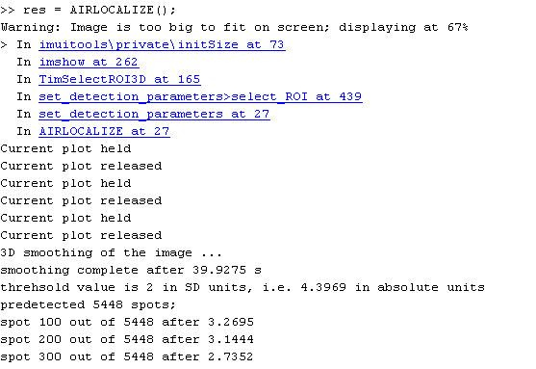
You then should be able to monitor the progress of the spot fitting in the command window.

Slide 12
Automated saving
Saves in your selected directory 2 files:
The .loc3 file is a text file that contains the array with position, Intensity and frame number
The .par3 file is a text file that contains the parameters
The .det file is a matlab file containing both the results and parameters
Note that (x,y) coordinates are inverted from the Image J conventions.
The basename of each file is that of the original image (except for movies).

Slide 13
Advanced parameters
The size
of the
local ROI around each spot
on which the fit
is performed
(units of the
PSF width)
Used to output
the final_spots
array
in physical units
rather than pixels
Type of method used.
Gaussian mask is the most robust.
Thickness
of the pixel set
used to define
the
background
around the
local ROI
(local background)
In the smoothing filter,
sets the value of
the lower cutoff
Frequency
Type of background
correction:
Global on the image
linear fit around
the ROI
Median of the pixels
surronding the ROI
Minimum distance
allowed between
predected spots
Maximum number of spots to be quantified
(if more spots are predetected,
keeps only the brightest ones)
Maximum number allowed for the iterations
of the gaussian mask routine

Slide 14
Credits
Gaussian Mask Algorithm: Dan Larson
Tiff reader: Nedelec Lab
ROI selection: Andriy Nych

